Slide 1

⚽ Football AI Prediction System
Leveraging Machine Learning for Advanced Player Analytics

Slide 2




Unlocking Player Potential with AI
Predicting On-Field Performance
Estimating Market Value
Forecasting key statistics such as Goals and Assists for upcoming matches.
Providing accurate transfer price estimations in millions, crucial for club decisions.
Flexible Input Methods
Easily search for players in our database or enter custom statistics for bespoke analysis.

Slide 3
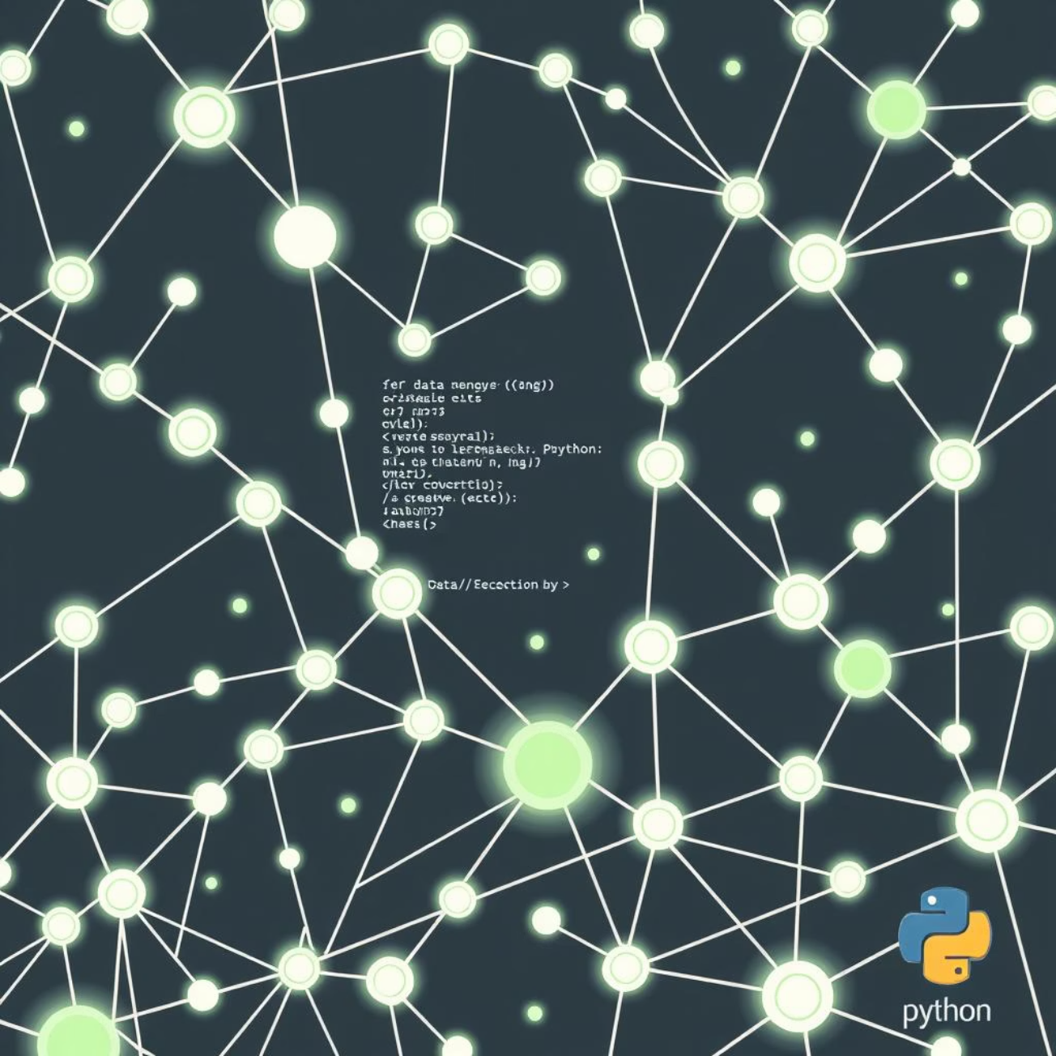
The Power Behind the Predictions: Technology Stack
Core Programming
Python 3.x
Python
Data Processing
Pandas, NumPy
Python
Machine Learning
Random Forest, Neural Network
Python
Graphical User Interface
CustomTkinter
Python
Search Algorithms
DFS/BFS Graph Algorithms
Python
Our system is built on robust, industry-standard technologies to ensure reliability and performance.

Slide 4





The Prediction Pipeline: How It Works
1. Load Player Data
Securely load extensive player statistics from CSV files.
2. Train ML Models
Our Random Forest and Neural Network models are rigorously trained on this data.
3. User Input
Users interact via player search or direct statistic entry.
4. AI Prediction
AI generates performance forecasts and market value estimations.
5. Display Results
Predictions are presented clearly through our intuitive GUI.

Slide 5


At the Core: Machine Learning Models
Random Forest: Ensemble Power
Comprises 100 decision trees, each casting a vote for the final prediction. Known for its speed and accuracy, especially with tabular data.
Neural Network: Pattern Recognition
A custom-implemented network with four layers (64→32→16→1 neurons) designed to uncover complex patterns in player data.
Both models work in tandem, allowing the system to leverage the strengths of each for optimal predictive performance, using the best available outcome.

Slide 6
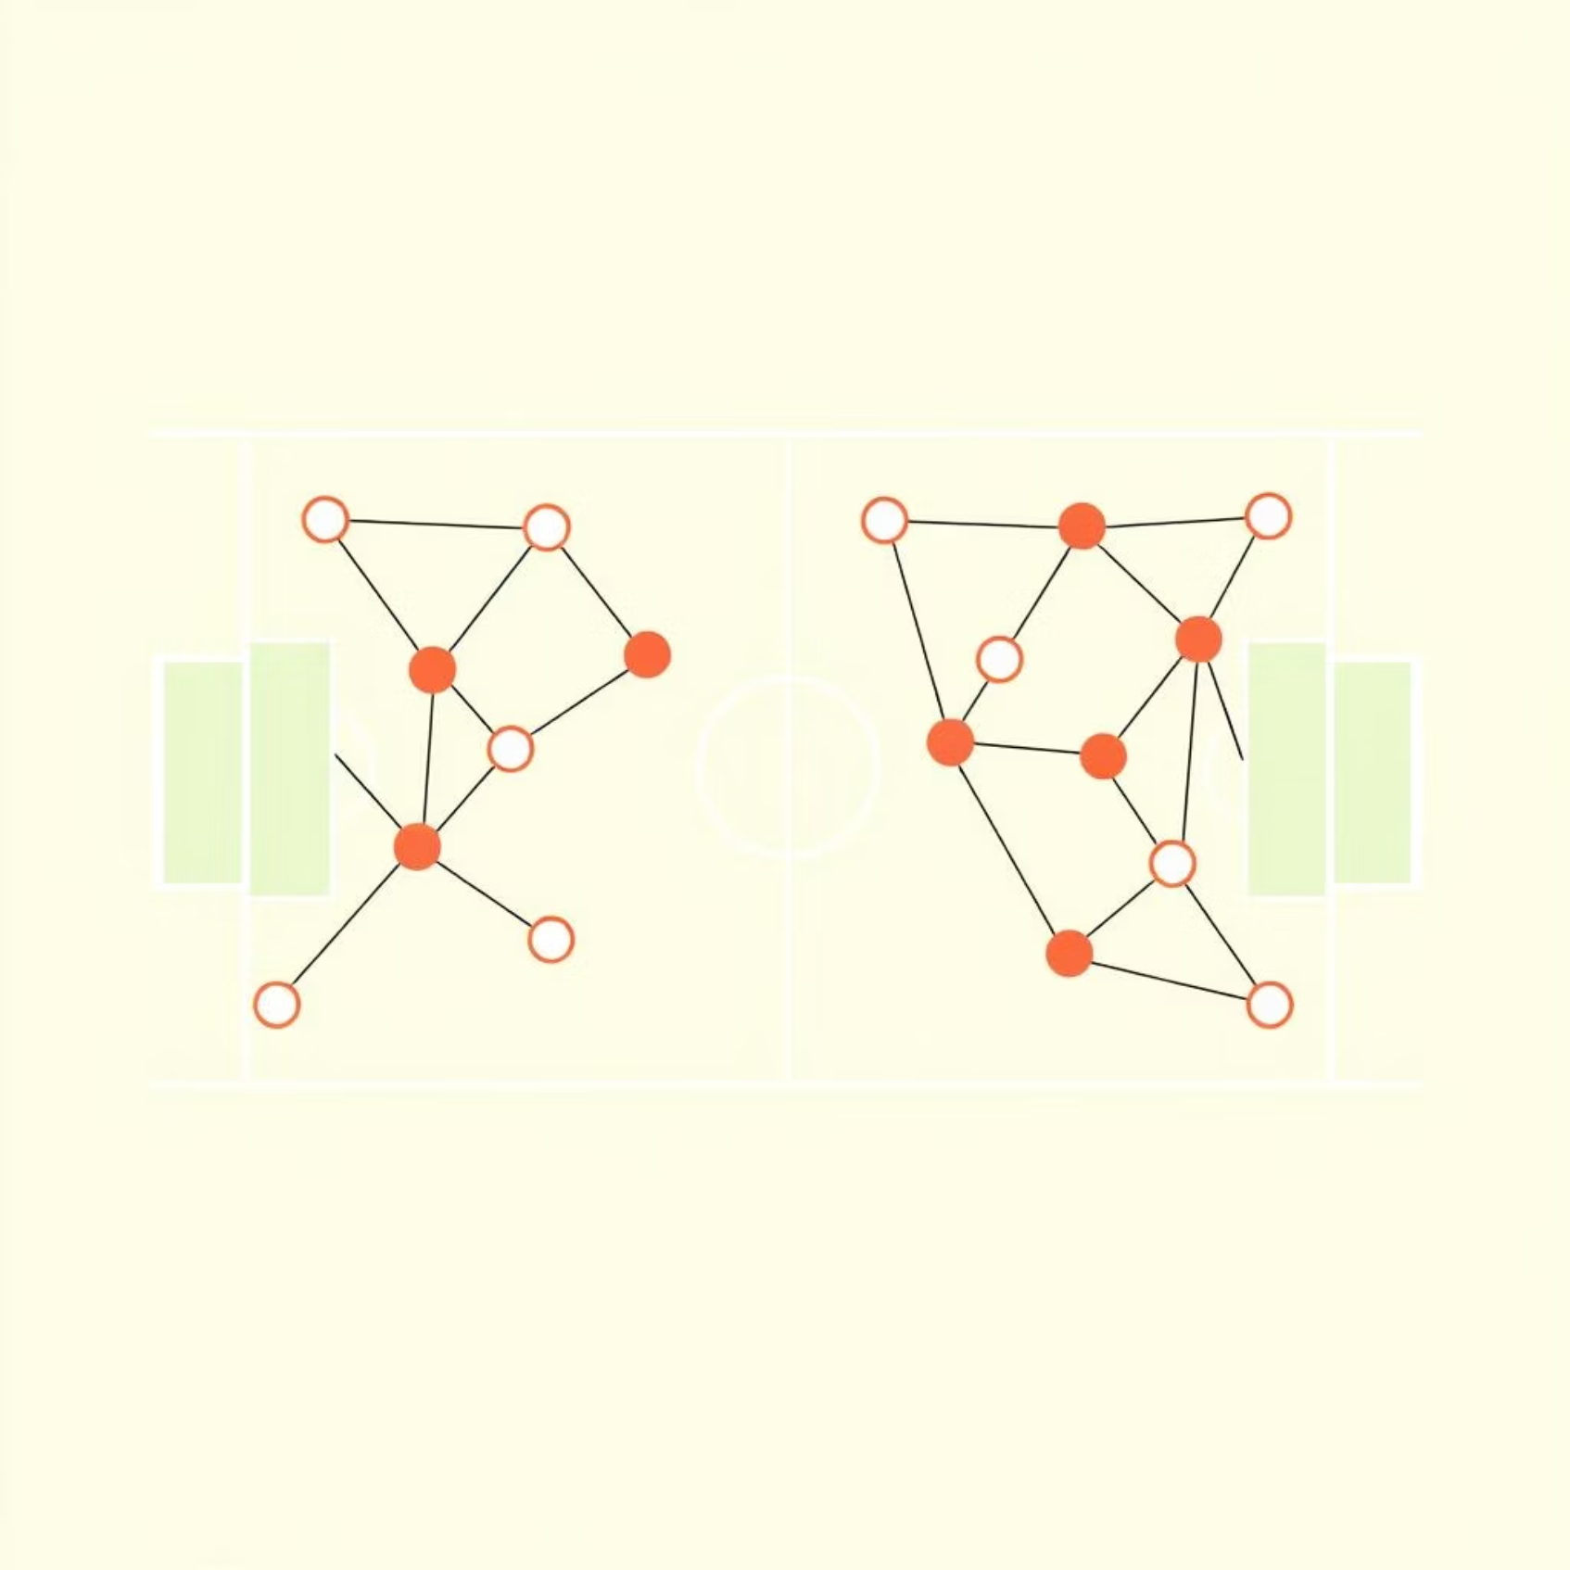
Intelligent Player Search: Graph-Based Algorithms
Our search functionality is powered by sophisticated graph algorithms, treating players as nodes and their teammates as edges.
DFS (Depth-First Search): Explores deep into branches, ideal for finding specific connections. Utilizes a Stack data structure.
BFS (Breadth-First Search): Explores widely across levels, excellent for finding closest relationships. Utilizes a Queue data structure.
Smart Search Features:
Fuzzy Name Matching: "Mesi" intelligently corrects to "Messi".
Keyword Search: Discover players using terms like "top scorer."
Teammate Search: Instantly find "teammates of Ronaldo."

Slide 7





Key Features: Delivering Excellence
Real Market Values
Seamlessly integrates with Transfermarkt database, supporting 8 major leagues for unparalleled accuracy.
Accurate Predictions
Trained on thousands of player profiles, considering age, current form, and playing time for robust forecasts.
Fast Performance
Leverages asynchronous processing and background threading to deliver instant, non-blocking results.
Modern UI
Features a sleek dark theme inspired by football field colors, animated predictions, and a user-friendly interface.

Slide 8
System Architecture: A Unified Approach
The diagram illustrates the modular design, ensuring efficient data flow and processing between distinct components, from user interaction to predictive analytics.

Slide 9

Project Organization: Simplified File Structure
Main Files:
main.py - The heart of the GUI Application.
train_models.py - Script for training the ML models.
Core Modules (src/):
predictor.py - Handles all prediction logic.
search.py - Implements search algorithms (DFS/BFS).
Data Files
model_trainer.py - Orchestrates model training.
neural_network.py - Contains the custom NN implementation.
data_loader.py - Manages CSV data loading.
data/All_Players.csv - Comprehensive player statistics.
models/*.pkl - Stores trained model parameters.
A well-organized structure ensures maintainability and scalability for future enhancements.

Slide 10
Get Started in 3 Easy Steps
01
02
03
Step 1: Train Models
Step 2: Run Application
Step 3: Get Predictions
python train_models.pyOnly needs to be run once to train the AI models on the latest data.
python main.pyLaunches the intuitive Graphical User Interface.
Option A: Search for any player by name.
Option B: Enter custom statistics for tailored analysis.
Result: Instant AI predictions for performance and market value!

